Slide 1



Mutation Rate Analysis and Gene Engineering
Molecular biology and basic cellular physiology and
Ethics, innovative research, businesses & IPR
[24AIM112] [24AIM115]
Guide:
Mrs. Reshma sanal
Dr. Neelesh Ashok
Team Members:
C M Prakateessh CB.AI.U4AIM24110
Mahashree C CB.AI.U4AIM24128
Reha Sreekumar CB.AI.U4AIM24146
Susanth Mohan Kamala CB.AI.U4AIM24148
1

Slide 2
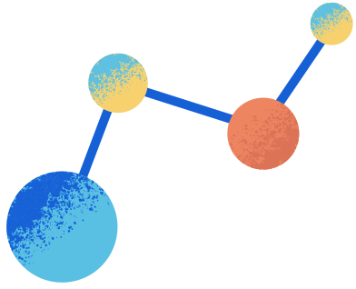
Introduction
Mutation rates influence gene stability, evolution, and genetic diversity.
High mutation rates can lead to genetic disorders and reduced gene functionality.
Understanding mutation patterns helps predict gene stability.
Ethical considerations are integral to gene engineering, ensuring responsible use of technologies like CRISPR to balance innovation with potential societal and environmental impacts.
2

Slide 3
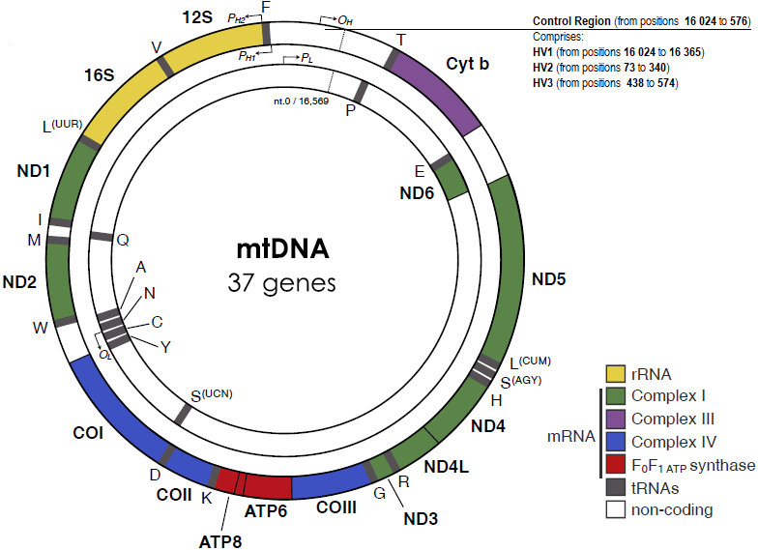
Objective
To compare the mutation rates among seven different species of mitochondrial gene.
To identify unstable genes and perform gene editing to enhance stability.
3

Slide 4
Literature Review
S.no | Title | Author | Year | Summary
1. | Correction of a Pathogenic Gene Mutation in Human Embryos | Hong Ma | 2017 | This study explored the application of CRISPR-Cas9 for correcting a dominant mutation(HCM) in the MYBPC3 gene. To improve gene correction efficiency and reduce mosaicism.
2. | A new era of mutation rate analyses: Concepts and methods | Kun Wu | 2024 | This review explores somatic and germline mutation rates using advanced sequencing techniques like whole-genome and long-read sequencing. It covers key evolutionary concepts, compares mutation rates across species and tissues, examines detection methods such as single-cell and duplex sequencing, and discusses technological improvements, research challenges, and influencing factors.
4

Slide 5
S.no | Title | Author | Year | Summary
1. | Ethical considerations of gene editing and genetic selection | Jodie BA | 2020 | This paper discusses the historical development of gene editing, tracing its roots from early DNA modification techniques to modern approaches like CRISPR-Cas9. It emphasizes ethical concerns, particularly regarding genetic selection and the impact on human dignity. The study highlights the potential misuse of genetic engineering and the necessity for regulatory frameworks​. Technologies discussed, germline editing.
2. | "Genome Editing with the CRISPR‐Cas System: An Art, Ethics, and Global Regulatory Perspective" (Plant Biotechnology Journal, 2020) | Debin Zhang | 2020 | This paper provides an extensive overview of CRISPR-Cas applications in plants, animals, and human biomedical research. It discusses the technology's efficiency, ethical concerns, and regulatory landscapes across different countries. The study also highlights patent issues and the moral implications of gene modifications​
3. | "Bioethical Issues in Genome Editing by CRISPR-Cas9 Technology" | Fatma Betül AYANOĞLU | 2020 | This review examines the bioethical challenges posed by CRISPR-Cas9. It discusses the risks associated with genome editing, including unintended mutations and long-term consequences. The paper also addresses regulatory concerns and ethical considerations in clinical and agricultural applications
5

Slide 6

Research Gap
Limited Cross-Species Comparative Studies
Inadequate Predictive Models for Gene Stability
Challenges in Mutation Identification
Unexplored Gene Engineering Approaches
Ethical and Regulatory Uncertainties
6

Slide 7
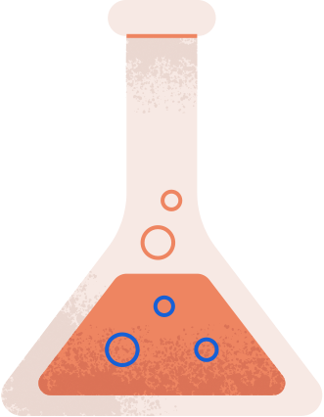
Problem Statement
Excessive or unstable mutation rates can lead to genetic disorders, reduced gene efficiency, and evolutionary disadvantages.
Despite advancements in bioinformatics and genetic engineering, predicting gene stability and mitigating harmful mutations remains a challenge.
By addressing these challenges, this project seeks to provide insights into evolutionary genetics.
To develop practical applications for medical advancements while considering ethical implications.
7

Slide 8
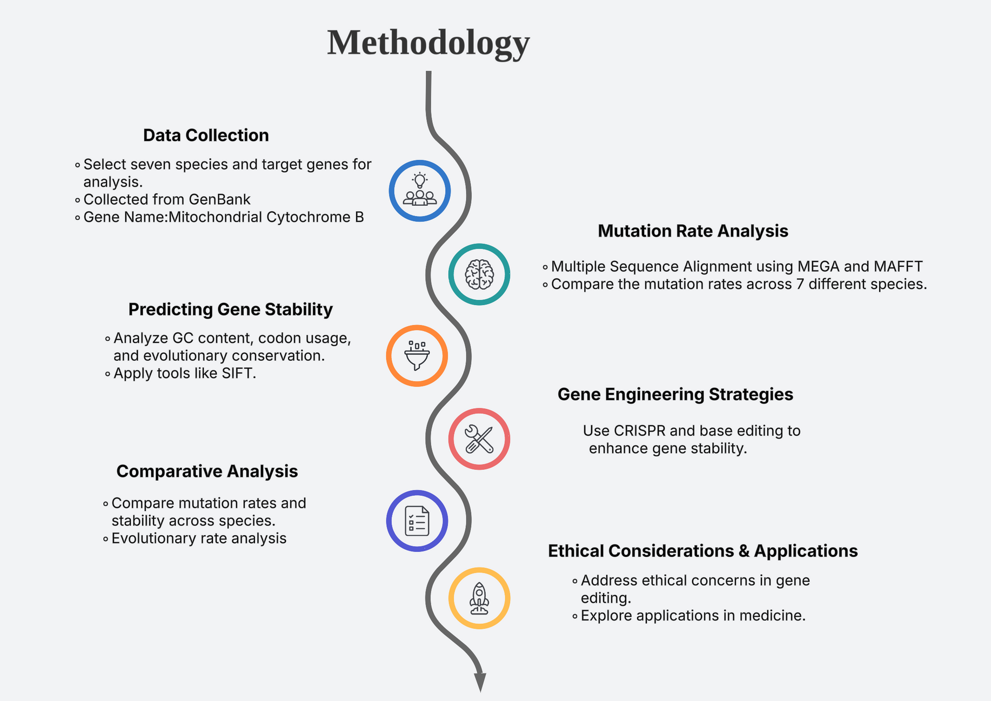
8

Slide 9

Role of Ethics
Ensuring Responsible Gene Editing. [Designer babies]
Avoiding Unintended Consequences. [Chinese scientist]
Regulatory Compliance Balancing Scientific Progress and Moral Values. [Human cloning]
Preventing Genetic Discrimination. [Insurance company]
Transparency and Public Trust.
Environmental and Biodiversity Considerations. [Mosquitoes]
9

Slide 10
Role of IPR and Patent
In the United States, Broad has been granted 31 CRISPR patents, including 26 patents for CRISPR-Cas9, as well as 3 for CRISPR-Cas12/Cpf1.
Patent No.10,000,772: which was issued in June 2018, covers methods of using optimised guide RNA formats (including single-guide and dual-guide formats) in certain environments, including eukaryotic cells (such as human, animal, and plant cells).
Application: Researchers at the Broad Institute of MIT and Harvard have developed a gene-editing treatment for prion disease that extends lifespan by about 50 percent in a mouse model.
Patent No.10,113,167: issued October 30, 2018, covers “Methods and compositions for RNA-directed target DNA modification and for RNA-directed modulation of transcription.”
Application: Scientists have discovered that about 5% of adult cancers rely on a gene called PELO to survive. If they disable the PELO gene, these cancer cells die.
10

Slide 11
Expected Outcomes
Accurate Mutation Rate Analysis.
Predictive Model for Gene Stability.
Effective Gene Engineering Strategies.
Cross-Species Comparative Insights.
Ethical and Regulatory Considerations.
.
11

Slide 12
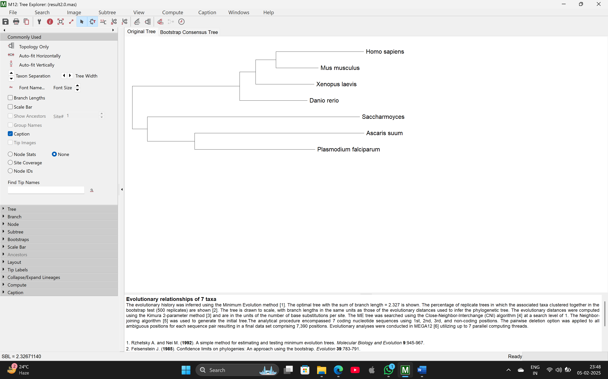
Phylogenetic Tree
12

Slide 13
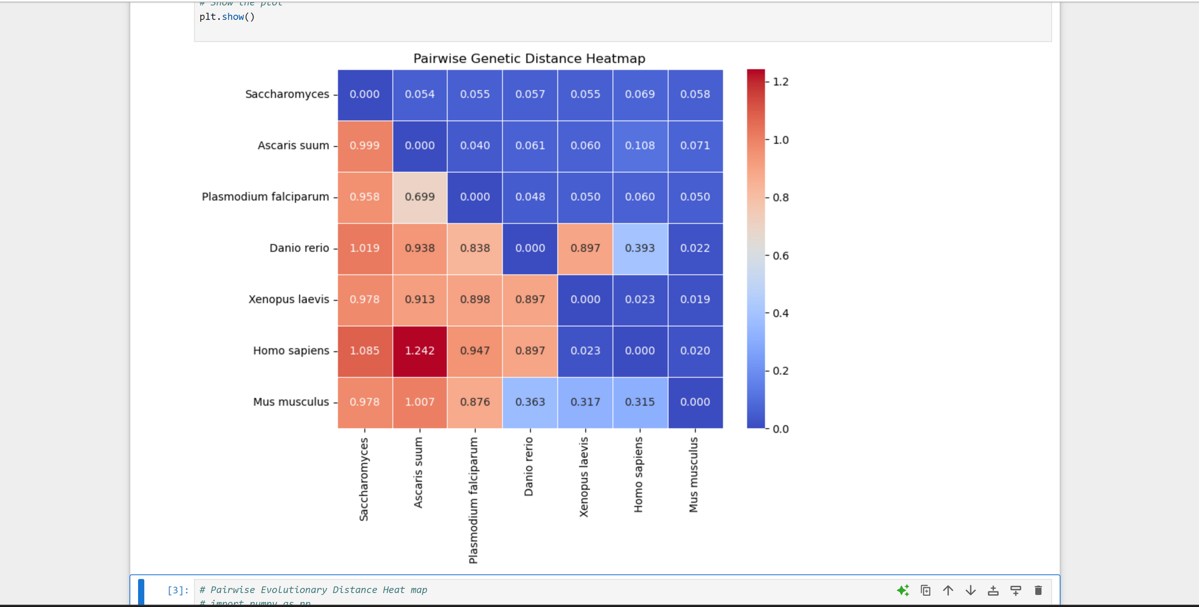
Confusion Matrix of Mutation Rate Analysis
13

Slide 14
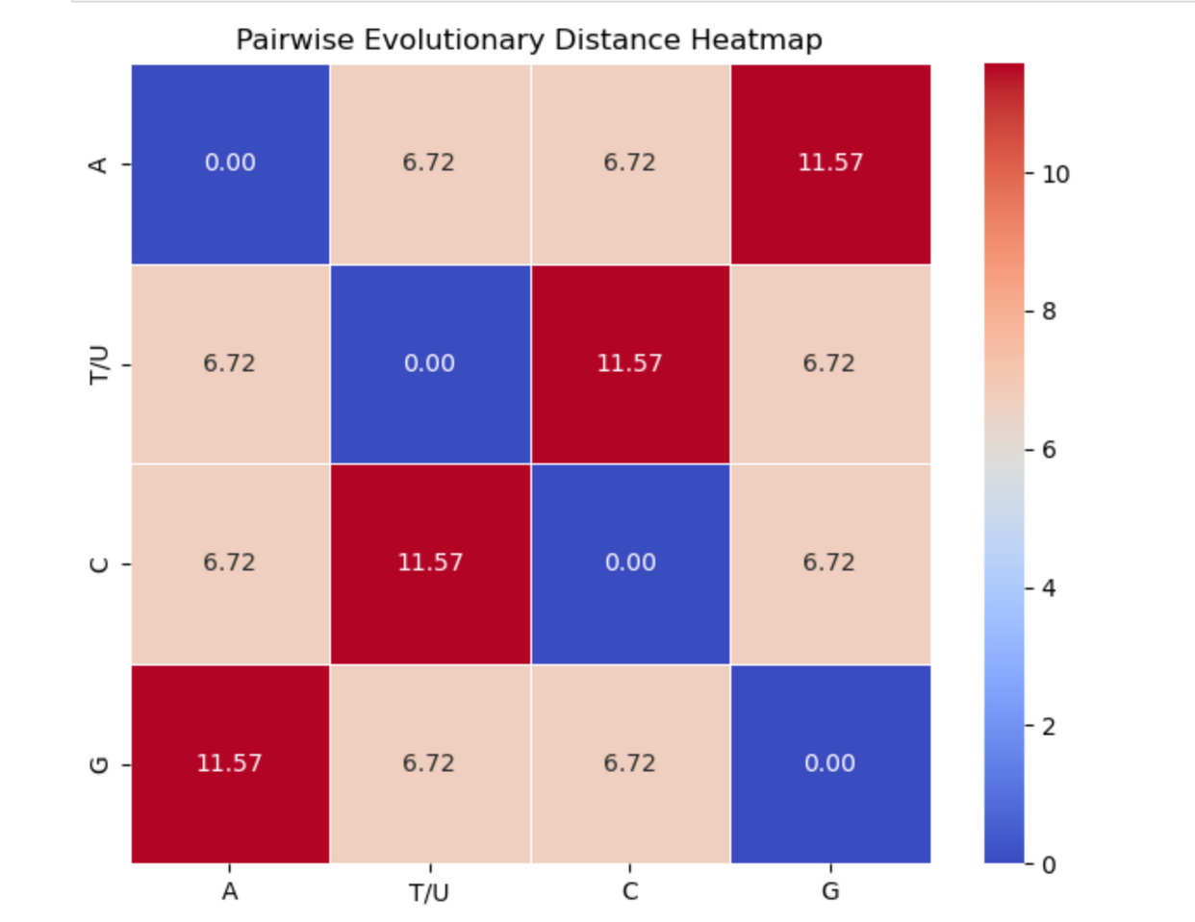
Confusion Matrix of Evolutionary Rate Analysis
14

Slide 15


CONCLUSION
This project highlights the importance of mutation rate analysis in understanding gene stability across species. By leveraging computational models, we identified mutation rates and predicted gene resilience. Gene engineering techniques, such as CRISPR, to stabilize genes and minimize harmful mutations, with potential applications in medicine.
Ethical considerations remain crucial, ensuring responsible use of genetic modifications while addressing concerns related to unintended consequences and biodiversity impact. This project offers insights into evolutionary biology and future genetic innovations.
15

Slide 16
THANK YOU!
16

